Slide 1
Project 4
Analysis of Apartment Rental Market in USA
Ella Ndalla

Slide 2
Overview
Objectives
Data Source
Feature Engineering
Machine Learning Methods: KMeans Clustering, PCA analysis and XGboost
Methodology Analysis
Results and Business Insights
Q&A session

Slide 3
Objectives
Understand the US apartment rental market to uncover rental segments and their features.
Provide insights to real estate developers and investors about:
Consumer demands (i.e. desired price and amenities)
Future investments for each segment ( i.e. new constructions, existing modifications)

Slide 4
Data Source
University of Irvine, Machine Learning repository.
The dataset consists of a listing of apartments for rent in the United States in Pre-Pandemic era(i.e. as of 12/25/2019)
Source: https://archive.ics.uci.edu/dataset/555/apartment+for+rent+classified

Slide 5
Feature Engineering
Created categories of apartments for rent based on the number of bedroom and bathroom for each unit.
Broke down the amenities column into 4 distinct categories of amenities based on the number of occurrence (i.e. outdoor, sports, luxury, convenience ) and added 4 new column to the dataset.
Normalized the price column (converted weekly listings into monthly rental prices)
Used encoding techniques to transform Boolean data such as “has Photo” or “has fee
Used “Get dummies” technique to transform apartment category column. The dataset generated 60 distinctive apartment categories.
Used StandardScaler method to scale numerical columns such as price, square feet, latitude and longitude

Slide 6
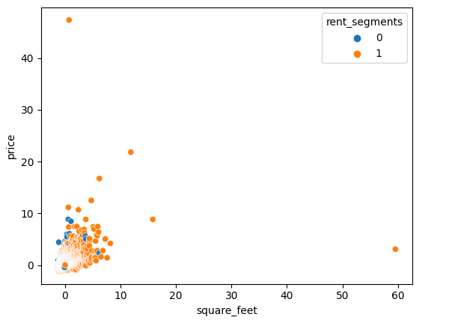
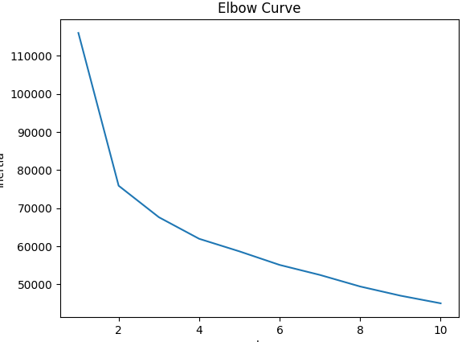
Machine Learning Methods
Kmeans Clustering : 2 clusters identified

Slide 7
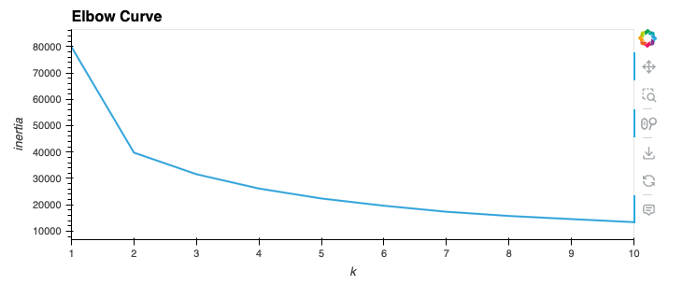
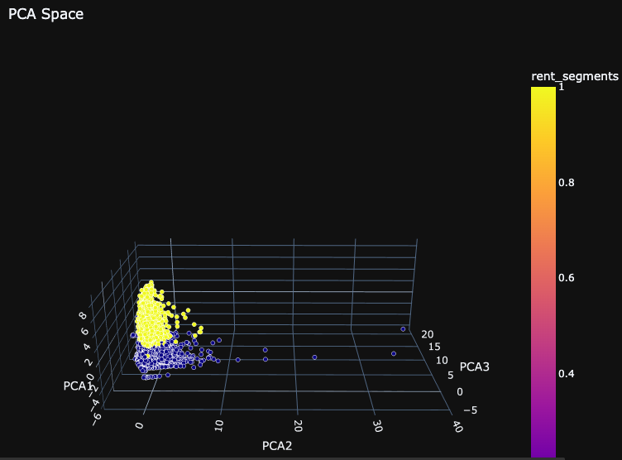
Machine Learning Methods cont’d
Principal Components Analysis : pca.explained_variance_ratio_ =69%

Slide 8
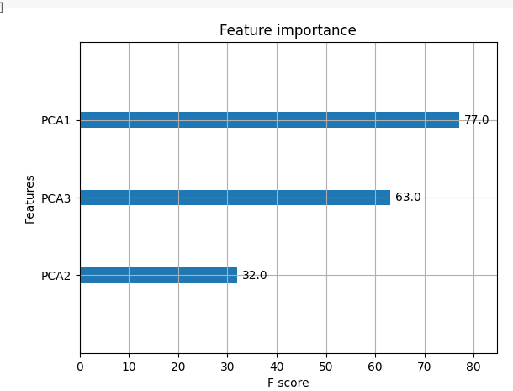
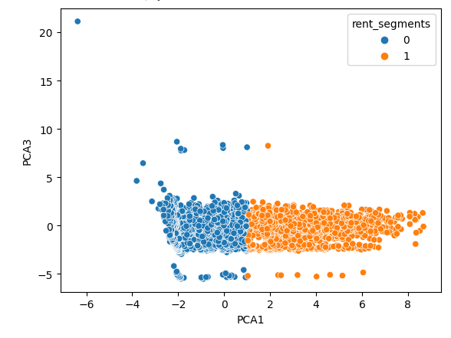
Machine Learning Methods cont’d
Pycaret and XgBoost to determine feature importance on PCA method

Slide 9
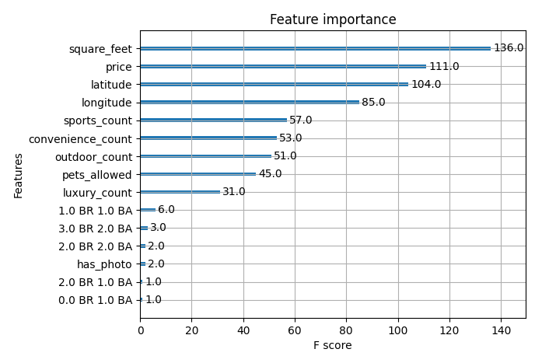
Machine Learning Methods cont’d
Pycaret and XgBoost to determine feature importance on KMeans method

Slide 10
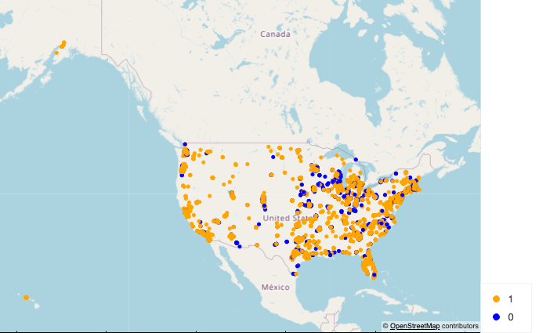
Results

Slide 11
Results cont’d CLUSTER 1 ANALYSIS
larger than cluster 0; which concurs with PCA analysis
Statistics:
Rental Price:
Average: $1,555
Median: $ 1,317
Maximum: $52,500
Minimum : $200
Square Footage:
Median: 843sq
Maximum: 11,318 sq
Minimum : 101sq
Luxury Amenities Count :
Median: 0
Maximum:: 4
Minimum : 0
Statistics:
Sports amenities count:
Median: 0
Maximum: 4
Minimum : 0
Convenience Amenities count:
Median: 0
Maximum: 3
Minimum : 0
Outdoor Amenities Count:
Median: 0
Maximum: 3
Minimum: 0
Notes:
Sports amenities include: Pool, Gym, Tennis, Basketball, Golf
Outdoor amenities include: Patio/Deck, Clubhouse, Playground
Convenience amenities include: Parking, Garbage Disposal, Washer Dryer, AC, Elevator, Dishwasher, Storage, Gated, Refrigerator,Cable or Satellite,Internet Access
Luxury amenities include: Fireplace, Wood Floors, View, Doorman, Luxury, Hot Tub

Slide 12
Results cont’d CLUSTER 0 ANALYSIS
smaller than cluster 1; which concurs with PCA analysis
Statistics:
Rental Price:
Average: $1,299
Median: $ 1,173
Maximum: $11,000
Minimum : $300
Square Footage:
Median: 750sq
Maximum: 40,000 sq
Minimum : 130sq
Luxury Amenities Count :
Median: 0
Maximum:: 4
Minimum : 0
Statistics:
Sports amenities count:
Median: 1
Maximum: 4
Minimum : 0
Convenience Amenities count:
Median: 5
Maximum: 10
Minimum : 3
Outdoor Amenities Count:
Median: 1
Maximum: 3
Minimum: 0
Notes:
Sports amenities include: Pool, Gym, Tennis, Basketball, Golf
Outdoor amenities include: Patio/Deck, Clubhouse, Playground
Convenience amenities include: Parking, Garbage Disposal, Washer Dryer, AC, Elevator, Dishwasher, Storage, Gated, Refrigerator,Cable or Satellite,Internet Access
Luxury amenities include: Fireplace, Wood Floors, View, Doorman, Luxury, Hot Tub

Slide 13
Conclusion
American rental markets can be broken into 2 segments:
spacious apartments - Cluster 1
Smaller apartments with several amenities – Cluster 0
Large metropolitan areas represent both segments based on neighborhoods
Smaller apartments are concentrated on the upper East side of the country
Some cities represent one segment exclusively:
Honolulu, HI – Cluster 1
Madison, WI – Cluster 0

Slide 14

Q&A

